Slide 1

Business Operations Analysis
Winnie

Slide 2
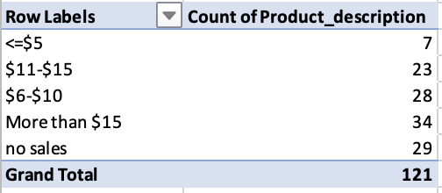
How many distinct products does Brand A have? Group products by selling price point (average retail per unit)
121 distinct products
92 distinct products with sales

Slide 3
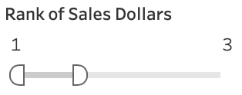
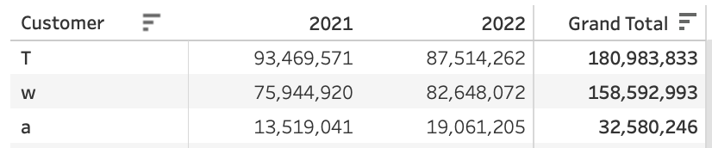
Top 3 Retailers in Both 2021 & 2022 T, W, a

Slide 4
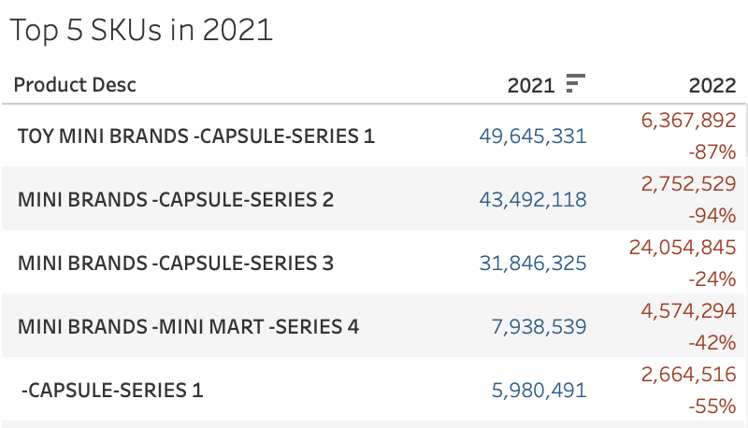
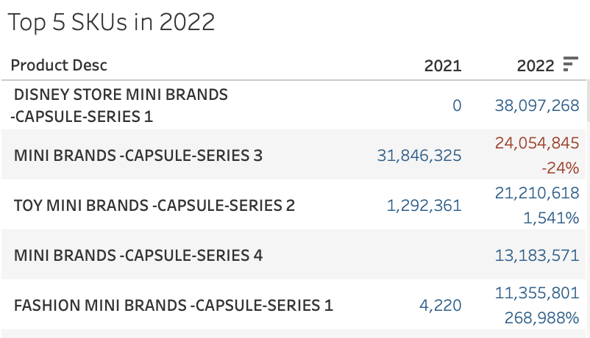
Top 5 Selling Product
2021
2022
MINI BRANDS -CAPSULE-SERIES 3 remained top 5 in both years

Slide 5
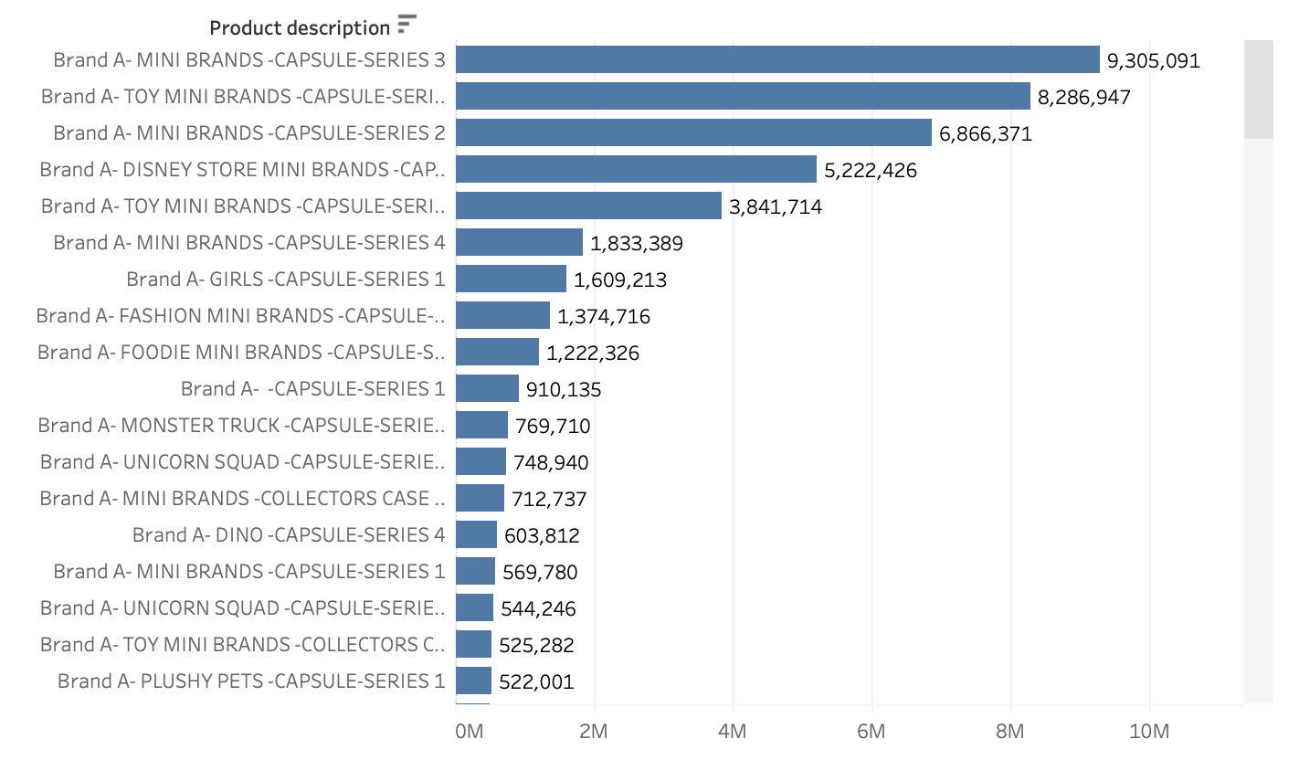
Products launched in 2022
Sum of sales units in 2021 = 0
Sum of sales units in 2022 > 0
Notes:
4.
IF
// Sum of sales units in 2021 should be 0
SUM(IF YEAR([Sales date]) = 2021 THEN [Sales units] ELSE 0 END) = 0 AND
// Sum of sales units in 2022 should be greater than 0
SUM(IF YEAR([Sales date]) = 2022 THEN [Sales units] ELSE 0 END) > 0
THEN 'Launched in 2022'
ELSE 'Not Launched in 2022'
END

Slide 6
Largest increase and decline year over year
Dollar Change:
Largest increase ($): DISNEY STORE MINI BRANDS -CAPSULE-SERIES 1 (+ $38,097,268)
Largest decrease ($): TOY MINI BRANDS -CAPSULE-SERIES 1 (- $43,227,439)
Percentage Change:
Largest increase (%): PLUSHY PETS -CAPSULE-SERIES 1
Largest decrease (%): UNICORN SQUAD -CAPSULE-SERIES 2
Notes:
5. Which product/series saw the largest increase and decline Year over year and why? (dollar increase)
([Current_Period_Sales] - [Previous_Period_Sales]) / [Previous_Period_Sales]

Slide 7
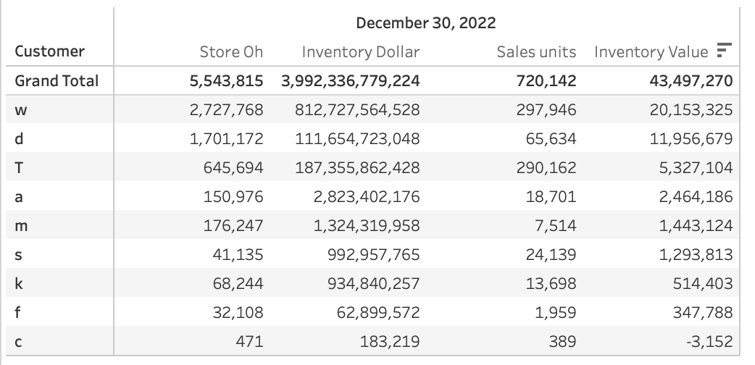
Ending Inventory Analysis for 2022:
Top-Contributing Product: W ($20M) had the highest ending inventory dollars at retail in 2022.
For US:
Overproduction / Low Sales: Potential misalignment between production and market demand.
Review Sales and Promotions: Align production and marketing strategies with demand.
Investigate Supply Chain: Ensure timely deliveries to match peak sales periods.
For Retailers:
Excess Inventory: May require markdowns or promotions, impacting profit margins.
Optimize Promotions: Reassess timing and effectiveness of promotions to avoid excess stock.
Manage Inventory: Consider adjusting pricing or running promotions to clear surplus inventory.
Inventory Dollar (Value)
= Store_oh * (Sales_Dollars / Sales_units)
Notes:
6. What were the ending inventory dollars (at retail) in 2022 across the brand? Which product contributed the most? What does it mean for ZURU and retailers?
Top-Contributing Product: W ($20M) had the highest
ending inventory dollars at retail in 2022.
Inventory Dollar (Value) = STORE_OH * (Sales_Dollars / Sales_units)
For ZURU:
Overproduction / Low Sales: Potential misalignment between production and market demand.
Action: Reassess production levels, marketing strategies, and sales forecasts.
Review Sales and Promotions: Align production and marketing strategies with demand.
Investigate Supply Chain: Ensure timely deliveries to match peak sales periods.
For Retailers:
Excess Inventory: May require markdowns or promotions, impacting profit margins.
Action: Consider inventory management strategies to optimize shelf space and clear stock.
Optimize Promotions: Reassess timing and effectiveness of promotions to avoid excess stock.
Manage Inventory: Consider adjusting pricing or running promotions to clear surplus inventory.

Slide 8
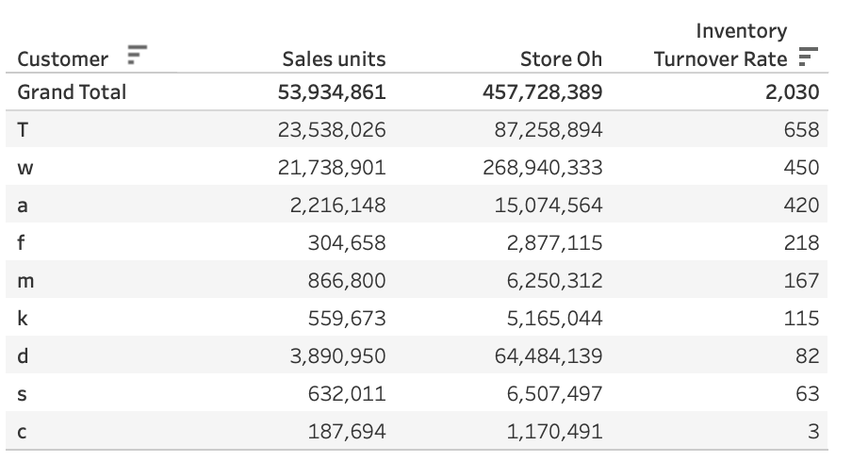
Which retailer is more efficient at managing inventory?
Inventory Turnover Ratio
= Sales Units / Average Inventory on Hand
Highest Ratio: Retailer T sells and replaces inventory the most frequently.
Improve Collaborations: Work closely with Retailer T to understand their methods and integrate best practices into your operations.
Retailer T is the most efficient at managing inventor
Notes:
7. Which retailer is more efficient at managing inventory?
More efficient at managing inventory, we can calculate and compare metrics like:
Inventory Turnover Ratio: This measures how often inventory is sold and replaced over a period.
A higher ratio indicates more efficient inventory management, as it means the retailer is selling and replacing inventory more frequently.
Inventory Turnover Ratio=Sales Units/Average Inventory on Hand =Average Inventory on HandSales Units​
2. Days Sales of Inventory (DSI): This measures how many days it takes for inventory to be sold.
A lower DSI indicates more efficient inventory management, as it means the retailer takes fewer days to sell their inventory.
DSI=Average Inventory on Hand/Sales Units per dayDSI

Slide 9
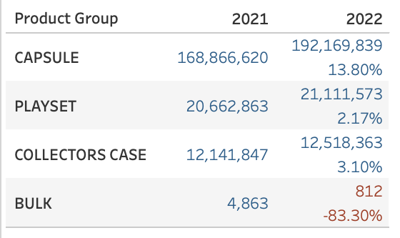
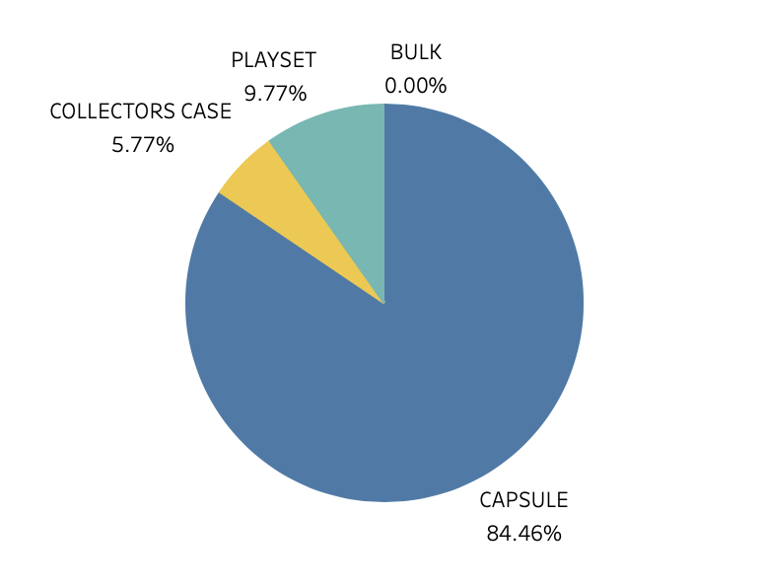
Product we should discontinue
Sales Growth by product group
BULK is the first group that should be discontinued
Negative Sales Growth (-83%)
Contributing to 0% of total sales
Collectors Case is another product group that could be considered to discontinued
Low Sales Growth (3%)
Contributing to 5.8% of total sales
% of Total Sales contributed by product group
Notes:
8. Is there a product group we should discontinue? Why?

Slide 10
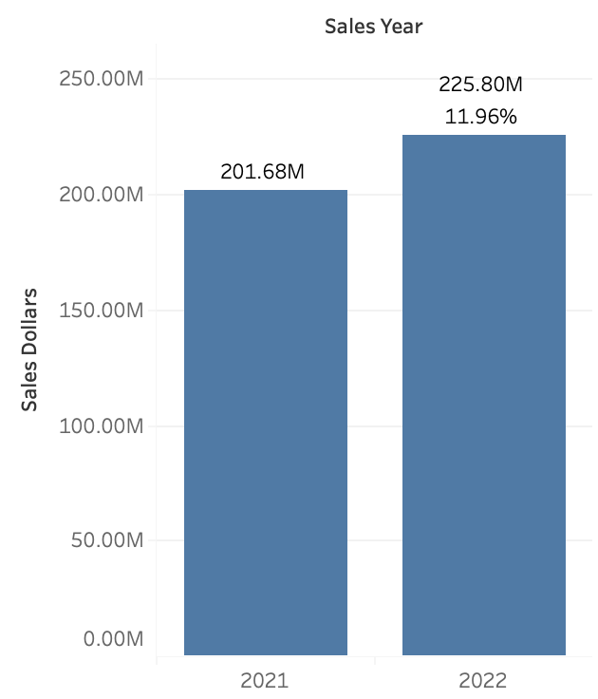
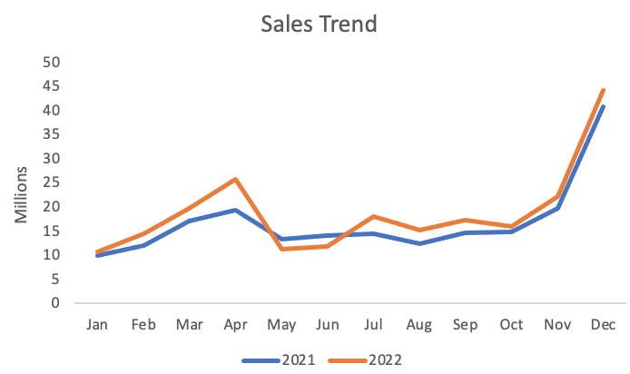
Brand A is a growing & Mature Brand
High Sales Growth: 11.96% total sales increase
2021 vs 2022: $201.68 Million vs $225.8 Million total sales
Notes:
Sales Growth: Brand A achieved an impressive 11.96% growth in sales from 2021 to 2022.
Current Status: The brand is demonstrating strong growth, reflecting successful strategies and market expansion.
Mature Aspect: If Brand A is established and has shown periods of stability, this growth indicates that it is currently experiencing a favorable phase of expansion or revitalization
Growing Brand
Positive YoY% Growth: Generally, a brand is considered to be growing if it has a positive YoY% growth rate.
Thresholds:
Threshold:
High Growth (10% or more)
Moderate Growth (5% to 10%)
Low Growth (1% to 5%)

Slide 11
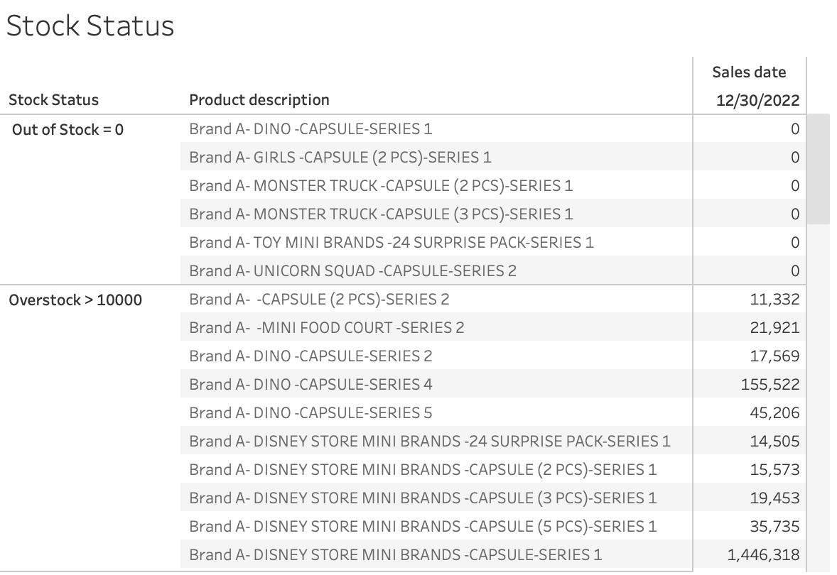
Product Out of Stock / overstock

